Slide 1

TC-446S
Professional License-free Radio

Slide 2
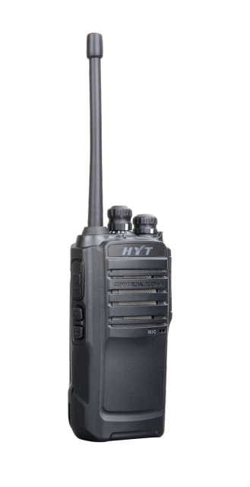
TC-446s Intro — Overview
HYT Nouvelle Generation Professionnelle Sans Licence
Pro & Fiable
Petit & Léger
Autonomie de 24H
Son Clair et Puissant

Slide 3
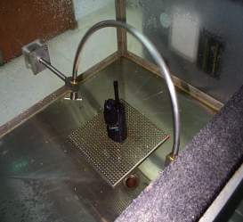

TC-446s Intro — Pro & Fiable
Pro & Fiable (1) – Certifié Testé Mil-Std810 C, D, E,
Mil-Std810 C, D, E, F
Radiation Solaire | Low air pressure | Haute temperature
Basse Temperature | Temperature shock | Humidité
Poussières | Pluie | Brouillard Salin
Vibrations | Chocs | Drop test
Pro & Fiable (2) – 5 Ans d’Utilisation Simulées en Laboratoire
Qualité du Produit Testé aprés 5 Ans d’ Utilisation Simulée en Laboratoire.
Testing items such as:
Humidité | Chocs
Haute et Basse temperature | Vibrations

Slide 4
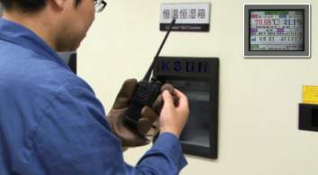
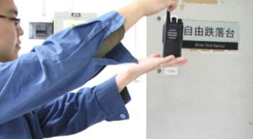
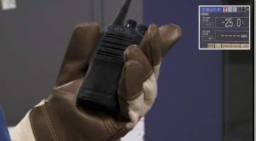
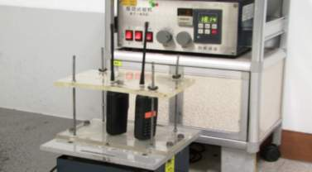
TC-446s Intro — Pro & Fiable
Pro et Fiable (2) – Simulation de 5 Années d’ Utilisation Intensive Accelerated Life Test )
1.5m de hauteur,
6 Aspect
3 essais de 21 fois
95%,
60℃,
Tests d’humidité
Tests Chocs
Vibrating for more
than 100,000 fois
65 ℃ - 25 ℃
Haute & Base temperature
Tests de Vibrations

Slide 5
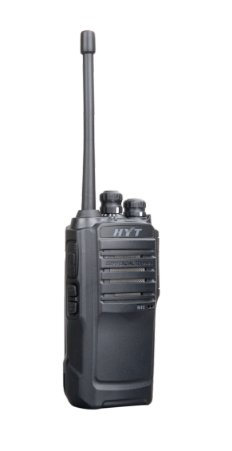
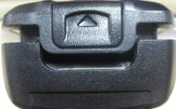


TC-446s Intro — Tough & Reliable
Tough & Reliable (3) – Reliable mechanical design
PTT bouton Testé + de 400,000 Fois
Loquet de Batterie Astucieux
Son Cristal + Large chambre de résonnance assurant une trés haute qualité d’écoute.
Grille en Acier protégeant le Haut- Parleur des poussières et des chocs
Vis de Fixation pour Accessoires

Slide 6
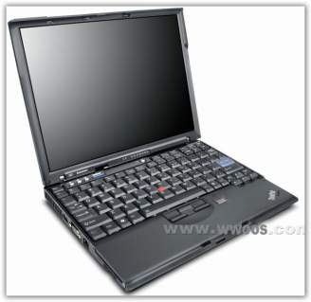
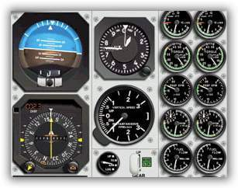
TC-446s Intro — Small-size & Light-weight
Small-size & Light-weight
Only
113×54×35
270g
PC1414 housing materials from GE
Amazing!!

Slide 7
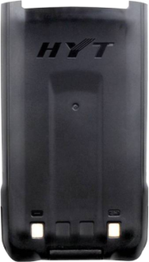
TC-446s Intro —Batterie Grande Autonomie
1650mAh Li-ion Battery
+ de 24 hours d’ Autonomie

Slide 8
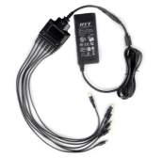
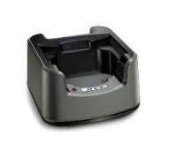
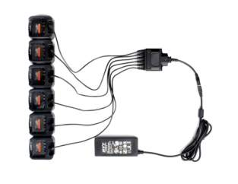
TC-446s Intro — Intelligent Charger
+
Six-unit Switching Power PS7002
Standard Charge
=
Intelligent “ Chargeur Multi- Unités”

Slide 9

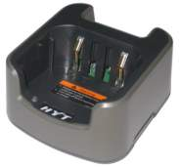
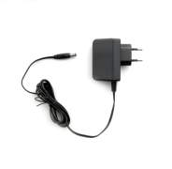


TC-446s Intro — Accessory
Standard accessory list
Li-Ion Battery (1650mAh) BL1719 | Rapid-rate Charger (for Li-Ion Battery) CH10L12 | Switching Power PS1018
Belt Clip Bc12 | Strap RO03

Slide 10







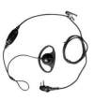






TC-446s Intro — Accessory
Operational accessory list
Li-Ion Battery (1300mAh) BL1301 | Vehicle Power Adapter CHV09 | Earbud with in-Line PTT & VOX ESM11 | Earbud with on-MIC PTT & VOX ESM12 | Programming Cable (COM Port) PC19
Earpiece with on-MIC PTT & VOX & Transparent Acoustic Tube EAM12 | D-earset with Boom MIC & VOX EHM16 | D-earset with in-line MIC & VOX EHM15 | Nylon Carrying Case (non-swivel) (black) NCN001 | Programming Cable (USB to Serial Port) PC26
Remote Speaker Microphone SM08M3 | Receive-Only Earbud (for use with remote speaker microphone) ESS07 | Receive-Only Earpiece with Transparent Acoustic Tube ESS08 | Cloning Cable CP05

Slide 11
TC-446s Intro — Main Functions
TC-446S Highlight Feature&functions
Voice-operated Transmit (VOX)
Battery Strength Indicator
Monitor
CTCSS/CDCSS and Squelch Tail Elimination
Scan
Battery Save
Low Battery Alert
Busy Channel Lockout
Time-out Timer (TOT)
PC Programmable
Wired Clone
Two Squelch Levels

Slide 12
TC-446s Intro — Specifications
General
Frequency Range | 446.00625 MHz–446.09375 MHz
Channel Capacity | 16
Channel Spacing | 12.5KHz
Operating Voltage | 7.4V
Standard1 650mAh | 1650mAh (Li-Ion)
Battery Life (5-5-90 Duty Cycle) | Up to 24 hours
Frequency Stability | ±2.5 ppm
Operating Temperature | -25℃ ~ +60℃
Antenna Impedance | 50Ω
Dimensions (H×W×D) (with standard battery, without antenna) | 113x54x35mm
Weight (with antenna & standard battery) | 270g
All Specifications are tested according to ETSI EN 300 296, and subject to change without notice due to continuous development.

Slide 13
TC-446s Intro — Specifications
Transmitter
Transmitter RF Output Power | 0.5W
Modulation | 8KΦF3E
Spurious and Harmonics | ≤ -36dBm (<1GHz) ≤ -30dBm (>1GHz)
FM Noise | ≤ -38dB
Audio Distortion | ≤ 5%
Receiver
Sensitivity | ≤0.282μV
Selectivity | ≥60dB
Intermodulation | ≥60dB
Spurious Response Rejection | ≥70dB
S/N | ≥40dB
Rated Audio Power Output | 800mW (Speaker impedance: 16 ohm)
Rated Audio Distortion | ≤5% (0.5W)
All Specifications are tested according to ETSI EN 300 296, and subject to change without notice due to continuous development.

Slide 14

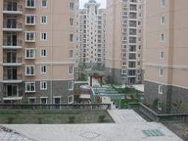


TC-446s Intro — Applications
Hospitaux
Sécurité
Restaurant
Magasins
TC-446S is a professional radio for commercial
market and entirely Deserves Your Trust !
Conclusion

Slide 15
MERCI

